Slide 1
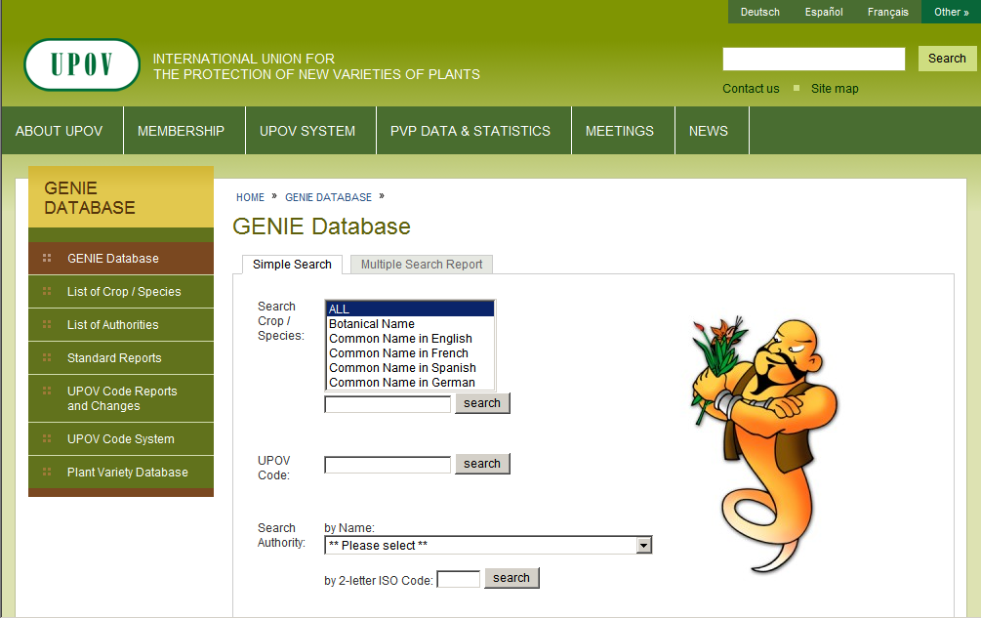
Step 1:
Select “List of Authorities”
http://www.upov.int/genie/en

Slide 2
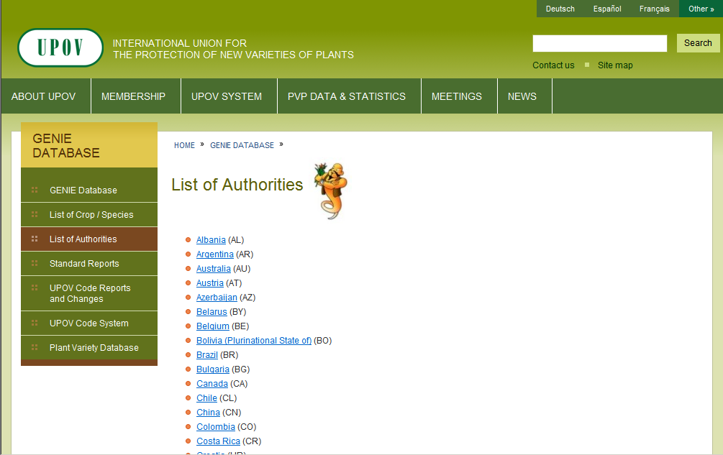
Step 2:
Select your authority (example: Australia)

Slide 3
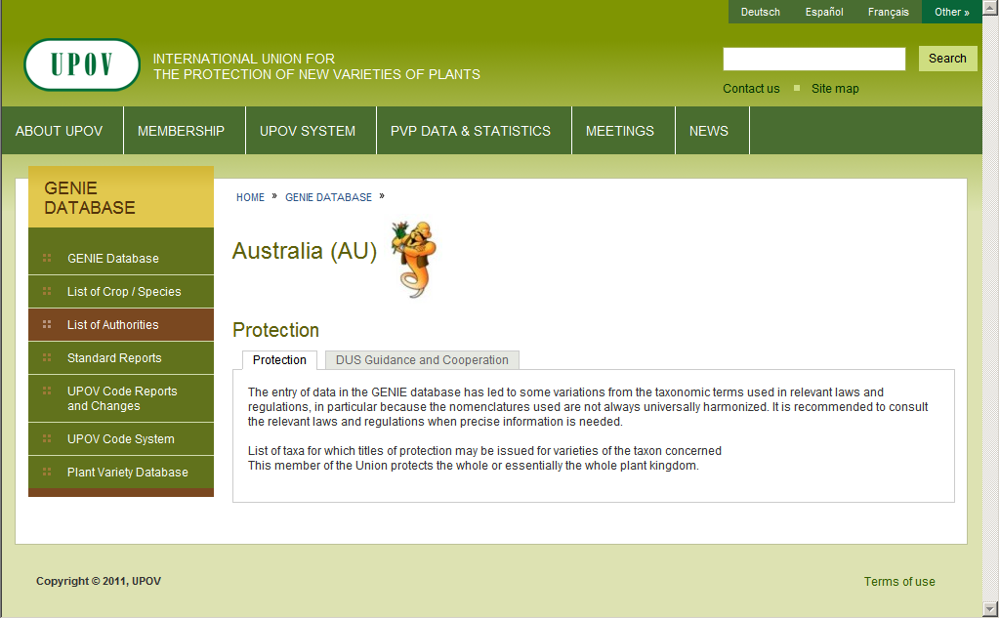
Step 3:
Select “DUS Guidance and Cooperation”

Slide 4
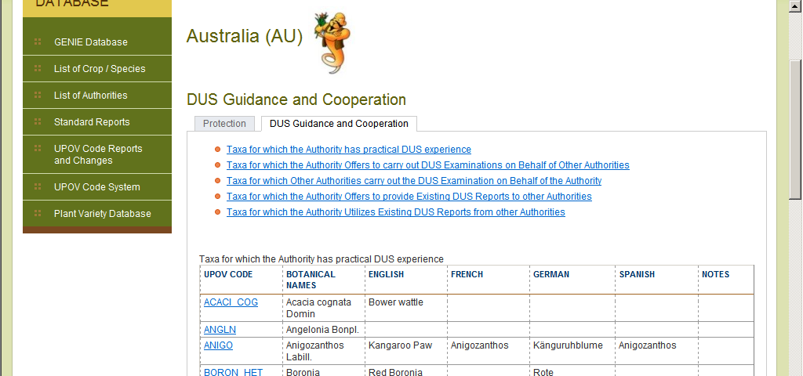
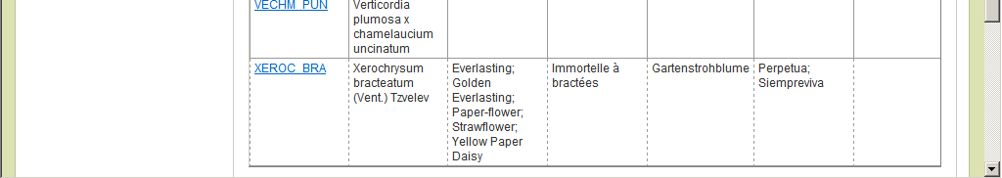
Step 4:
View “Taxa for Which the Authority has practical DUS experience”
Scroll down as necessary

Slide 5
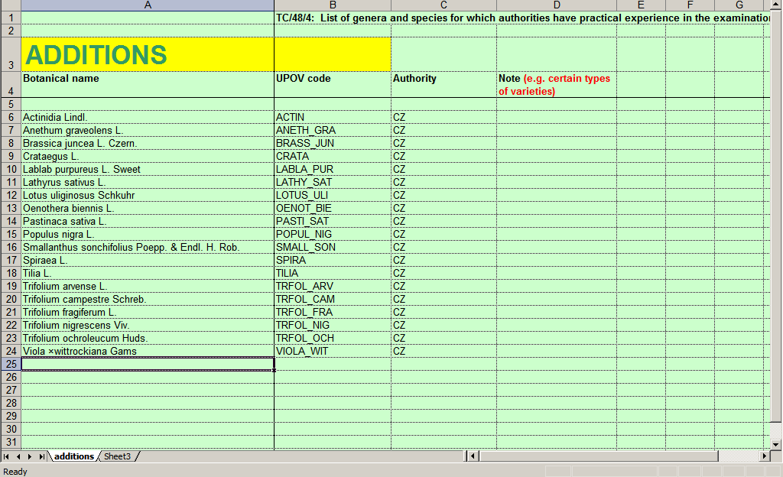
Step 5(a) – ADDITIONS
Complete spreadsheet “tc_xx_04_Practical_experience_ADDITIONS_en.xlsx” attached. Example:

Slide 6
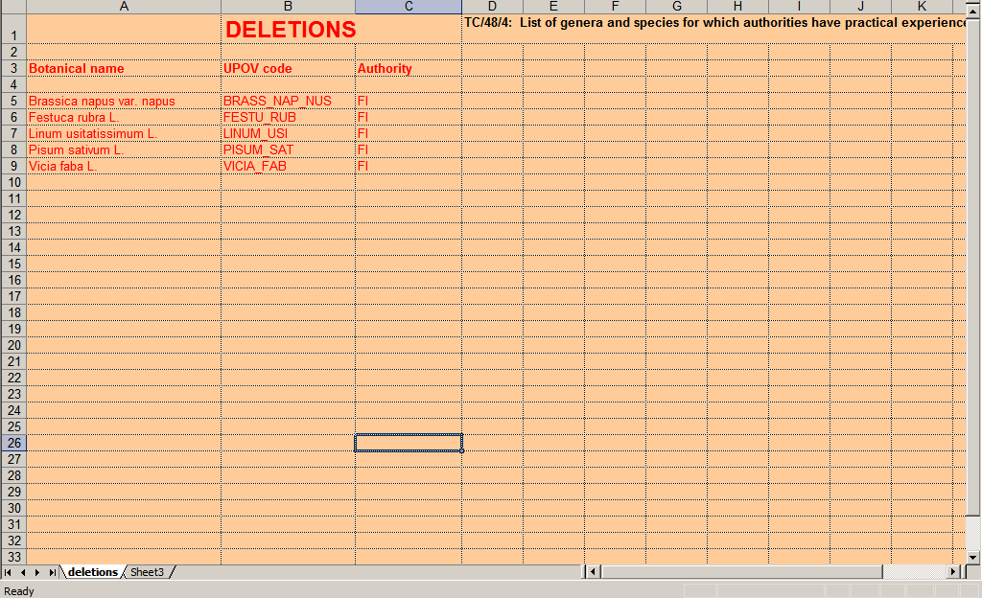
Step 5(b) – DELETIONS
Complete spreadsheet “tc_xx_04_Practical_experience_DELETIONS_en.xlsx” attached. Example:

