Slide 1
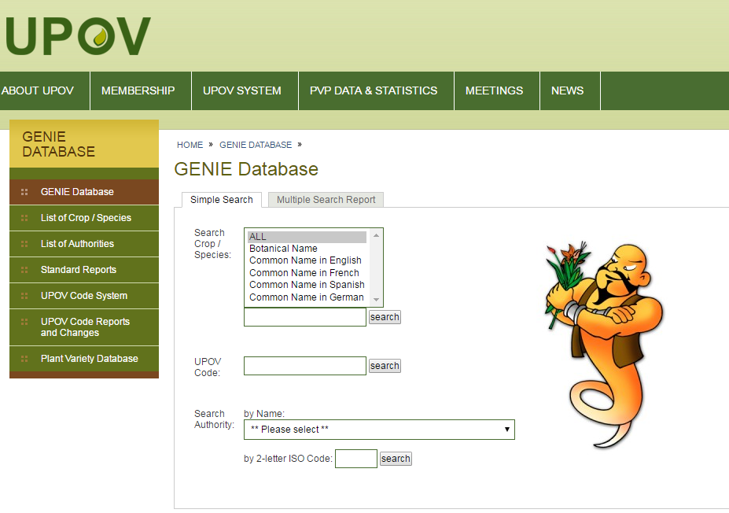
Step 1
Select “List of Authorities”

Slide 2
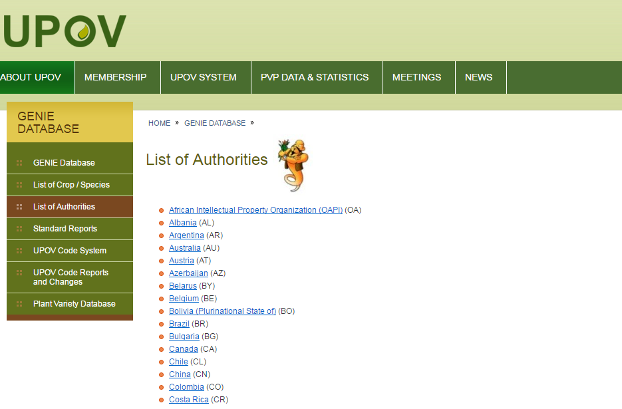
Step 2
Select your authority

Slide 3
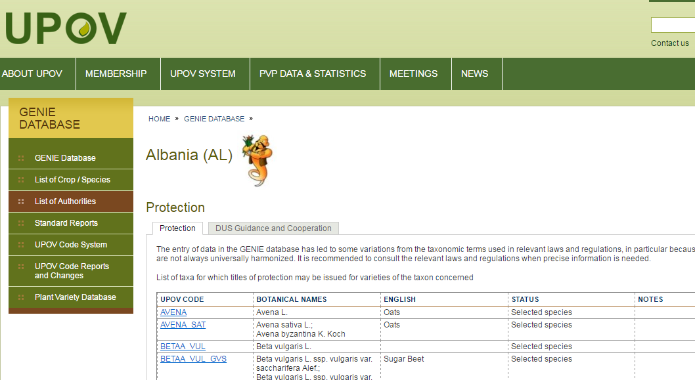
If relevant, review your data in the
“List of taxa protected by the members
of the Union” (document C/50/6)
Check your data concerning
“Cooperation in Examination”
(document C/50/5)

Slide 4

Preparation of document C/51/6
If relevant, review your data in the
LIST OF TAXA PROTECTED BY THE MEMBERS OF THE UNION

Slide 5
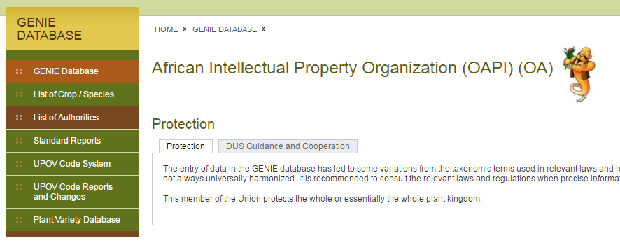
Example 1

Slide 6
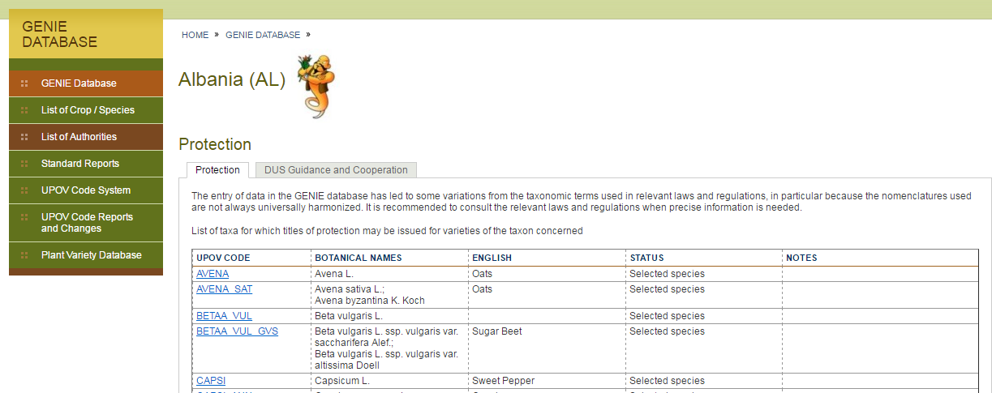
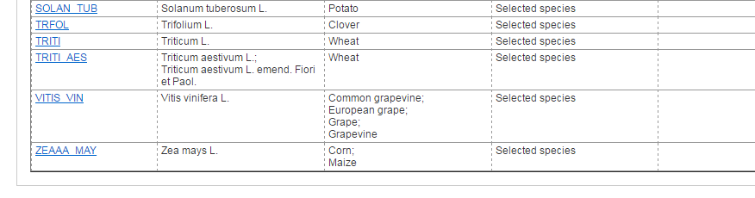
Example 2

Slide 7
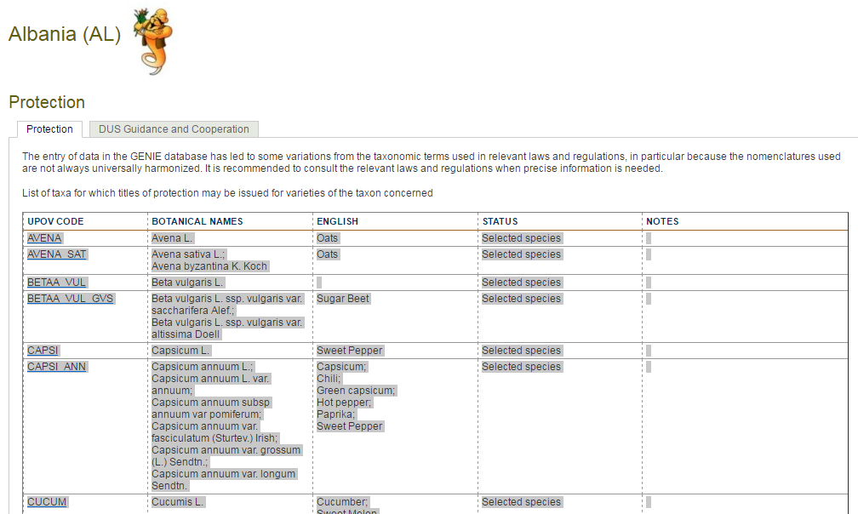
If you wish to copy into Excel sheet or Word table
Select text and “copy” and…

Slide 8
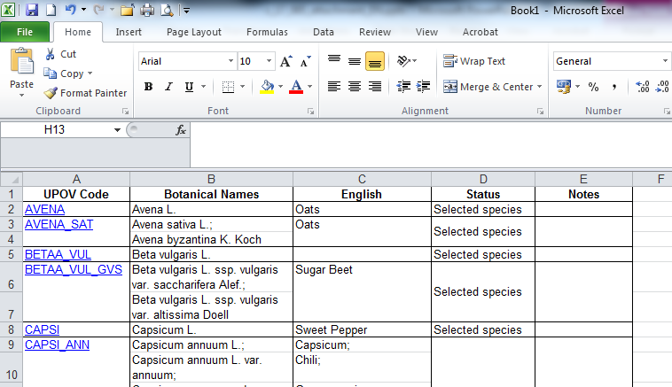
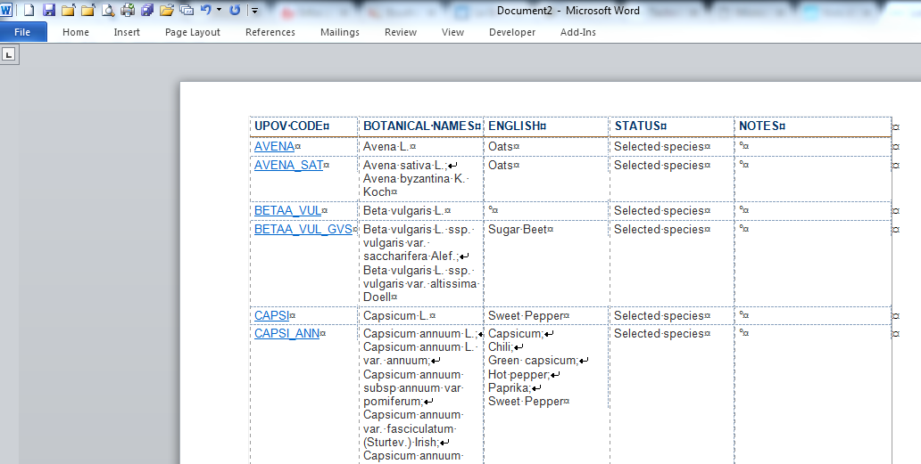
… “paste” into Excel spreadsheet or Word table

Slide 9
Preparation of document C/51/5
Check your data concerning
COOPERATION IN EXAMINATION

Slide 10
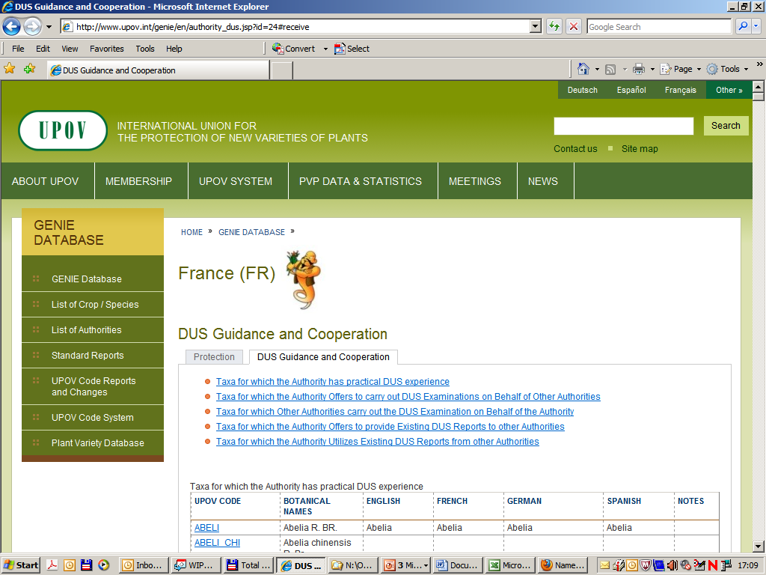
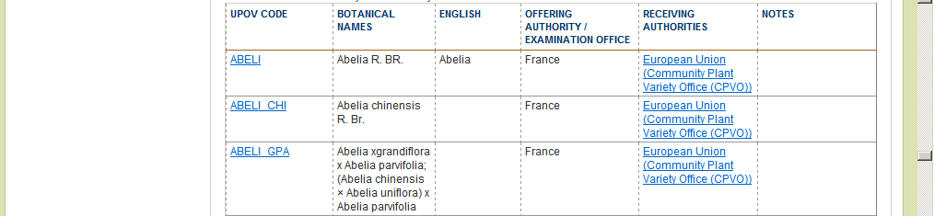

Slide 11
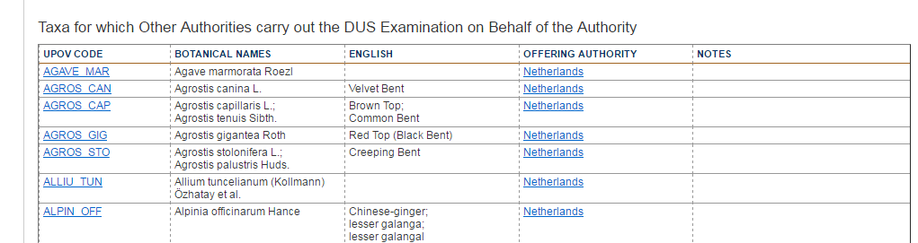
i.e. in this case: Netherlands offers to carry out DUS examinations on behalf of France

Slide 12
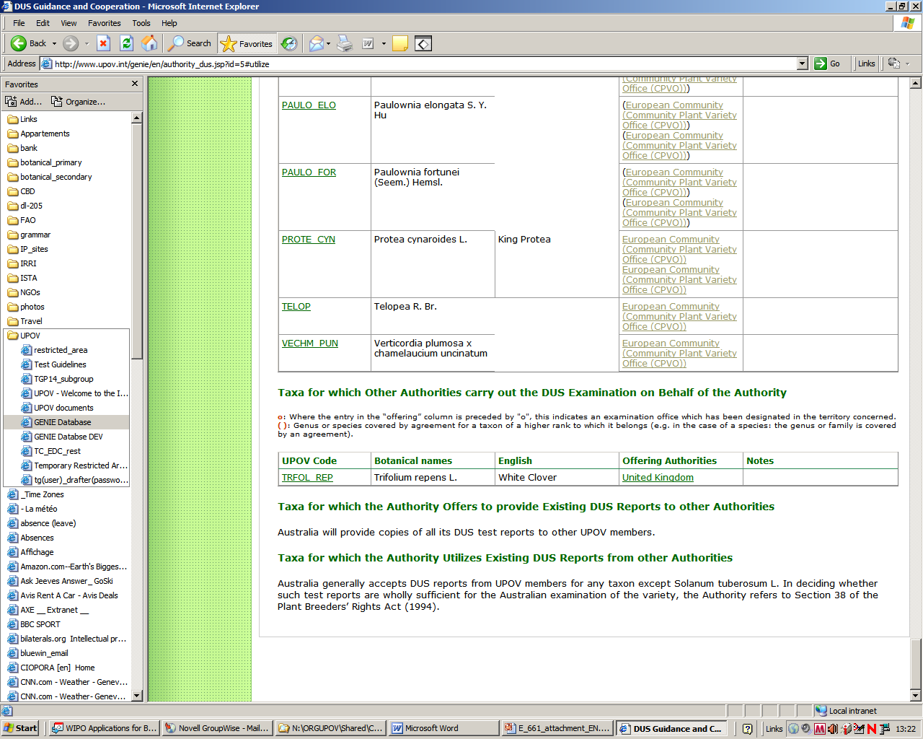
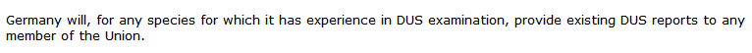
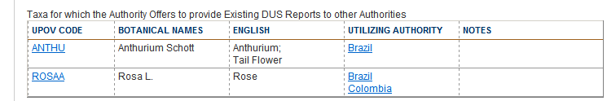
Examples
Australia (AU)
Germany (DE)
Republic of Korea (KR)

Slide 13
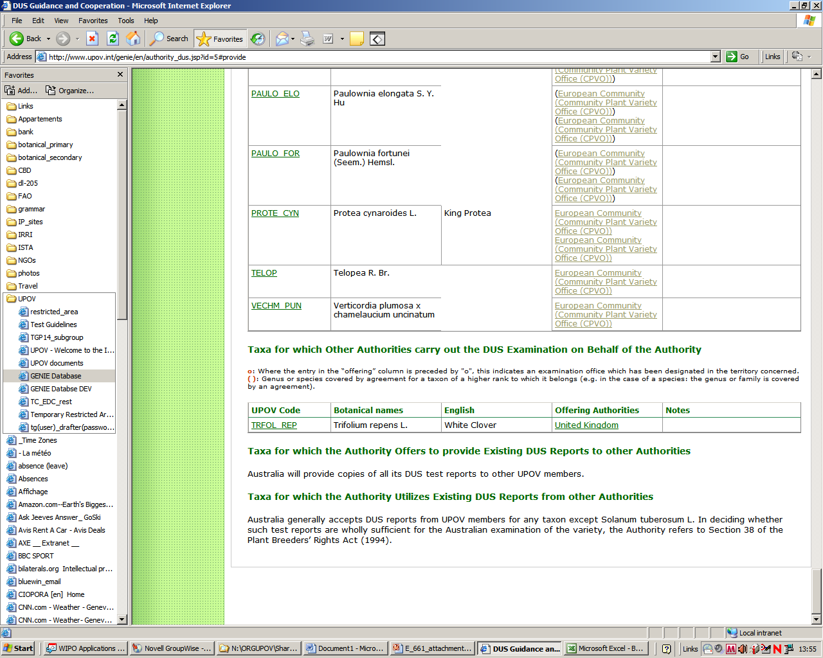
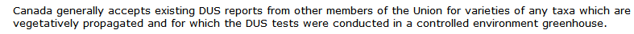
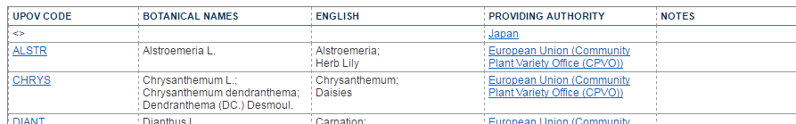
Examples
Australia (AU)
Canada (CA)
Kenya (KE)

Slide 14
If you wish to copy extracts into an Excel worksheet or Word table, please use the procedure explained in
Slides 7 and 8

