Slide 1
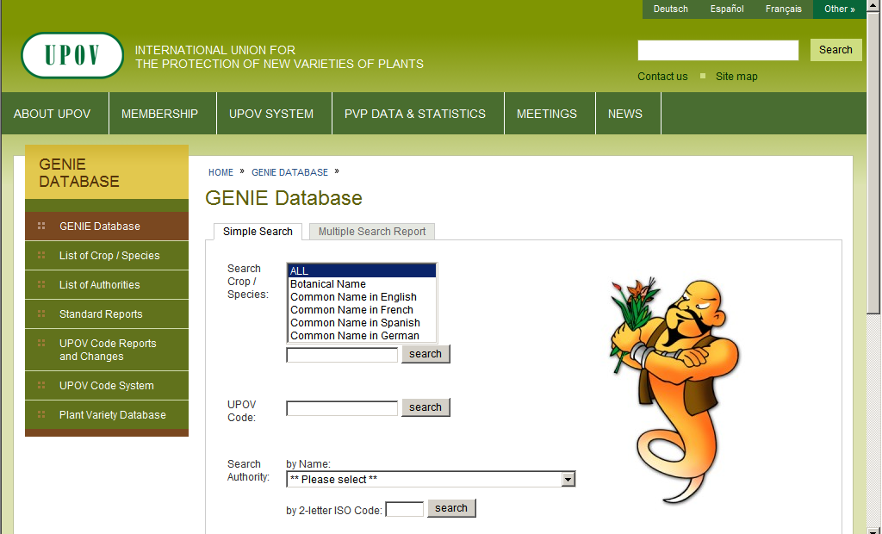
Step 1
Select “List of Authorities”

Slide 2
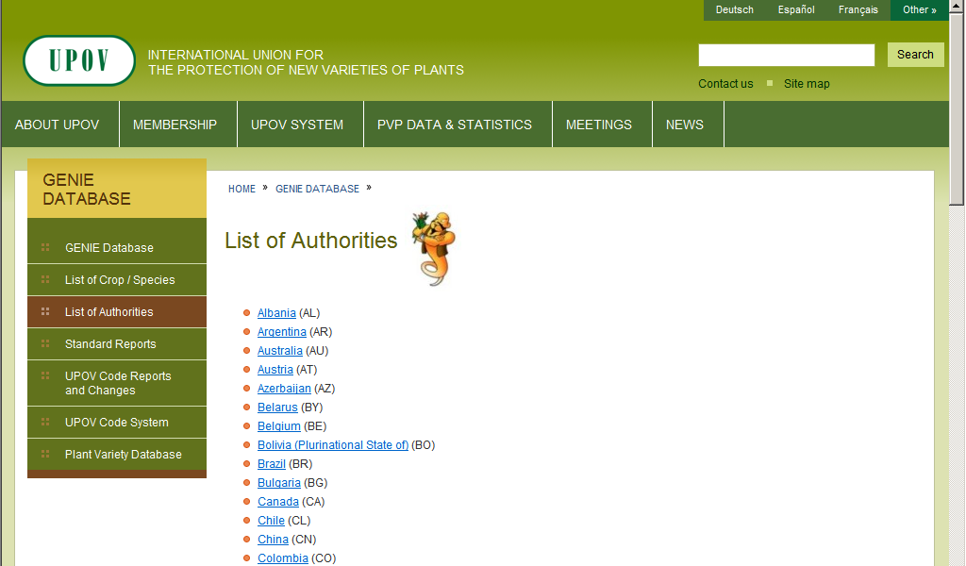
Step 2
Select your authority (example: Albania)

Slide 3
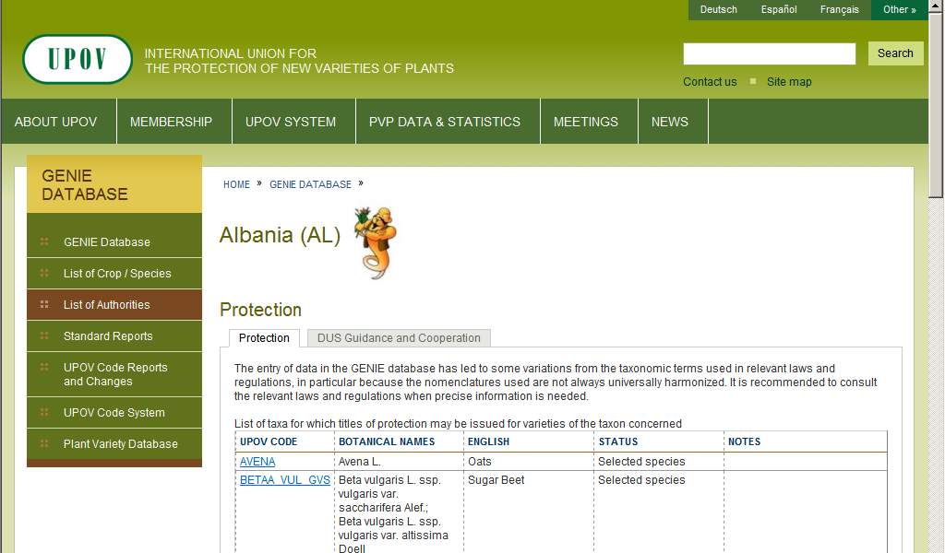
To check
“List of taxa protected by the members
of the Union”
(document C/48/6)
To check
“Cooperation in Examination”
(document C/48/5)

Slide 4
To check
“LIST OF TAXA PROTECTED BY THE MEMBERS OF THE UNION”
(document C/48/6)

Slide 5
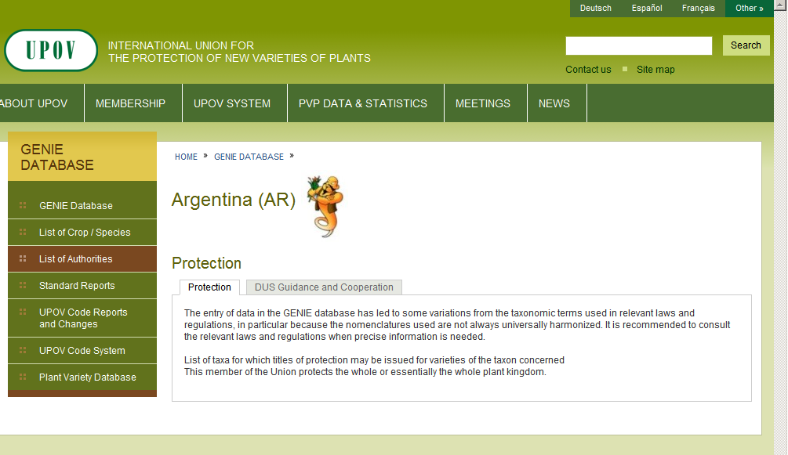
Example 1

Slide 6
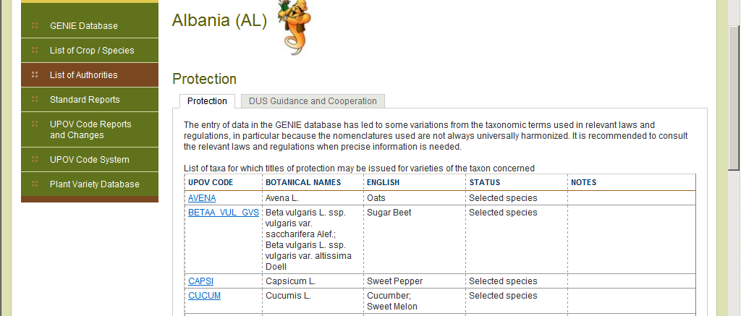
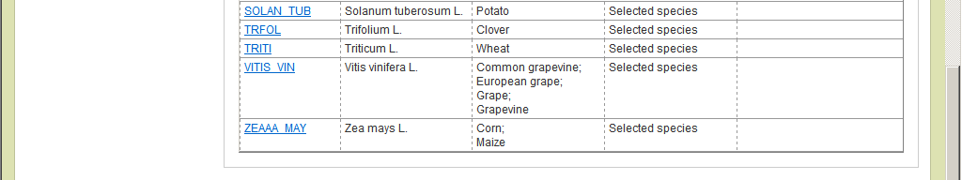
Example 2
Scroll down as necessary

Slide 7
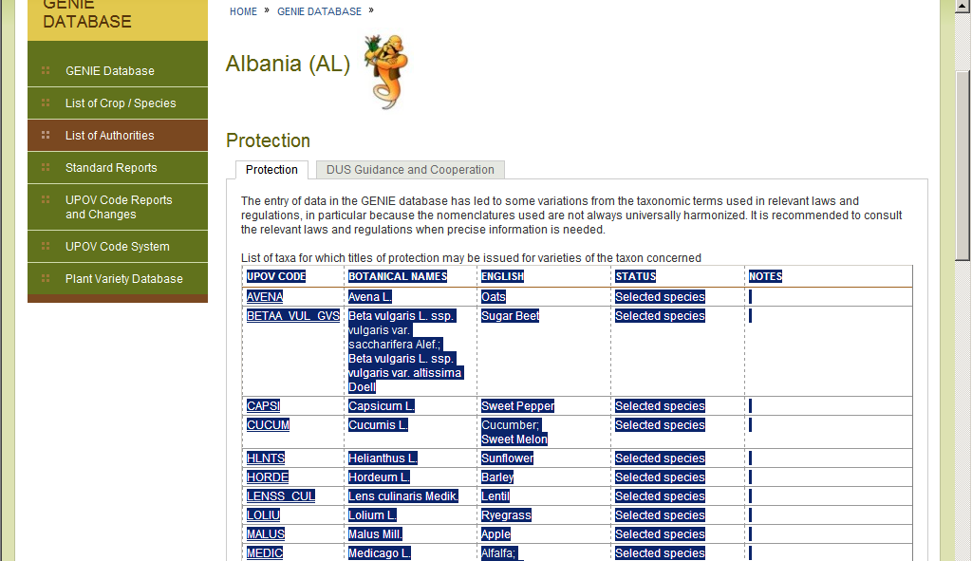
If you wish to copy into Excel sheet or Word table (only possible from Microsoft Internet Explorer)
Select text and “copy” and…

Slide 8
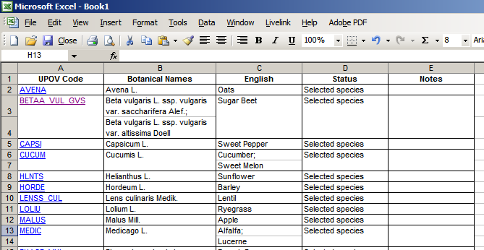
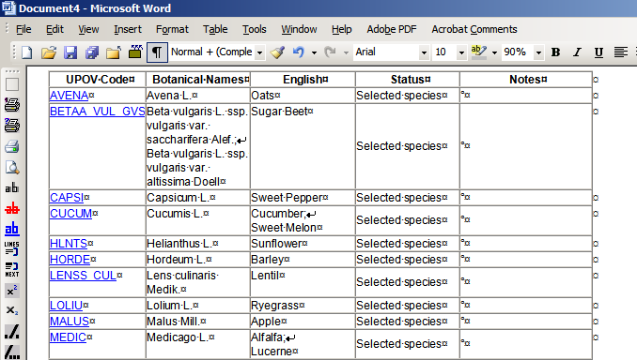
(if you wish to copy into Excel sheet or Word table (only possible from Microsoft Internet Explorer))
… “paste” into Excel spreadsheet or Word table

Slide 9
To check
“COOPERATION IN EXAMINATION”
(document C/48/5)

Slide 10
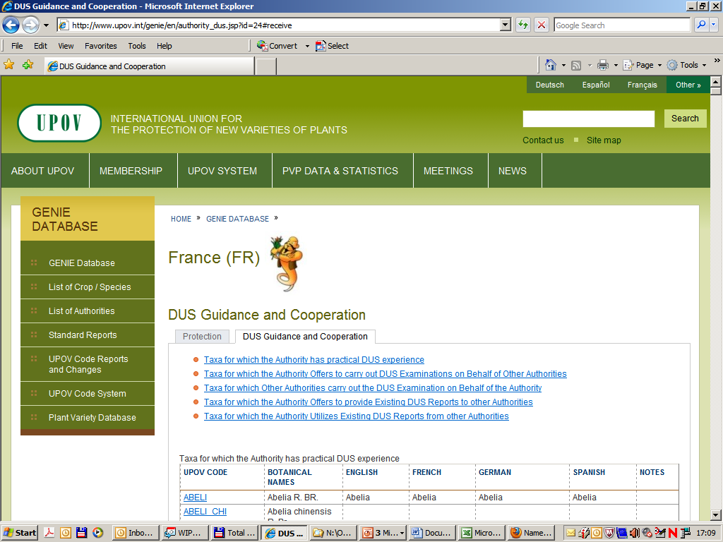
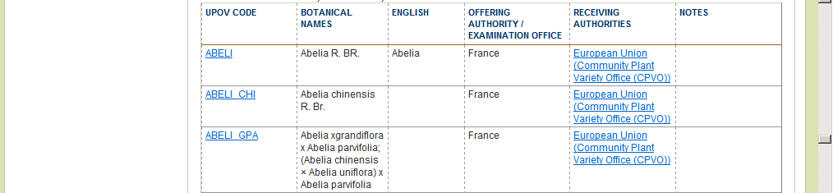

Slide 11
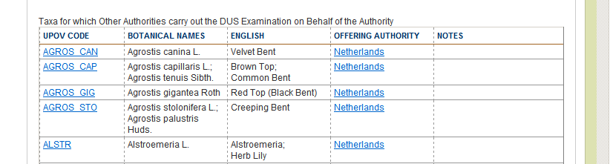
i.e. in this case: the Netherlands offers to carry out DUS examinations on behalf of France
i.e. in this case: the Netherlands offers to carry out DUS examinations on behalf of France

Slide 12
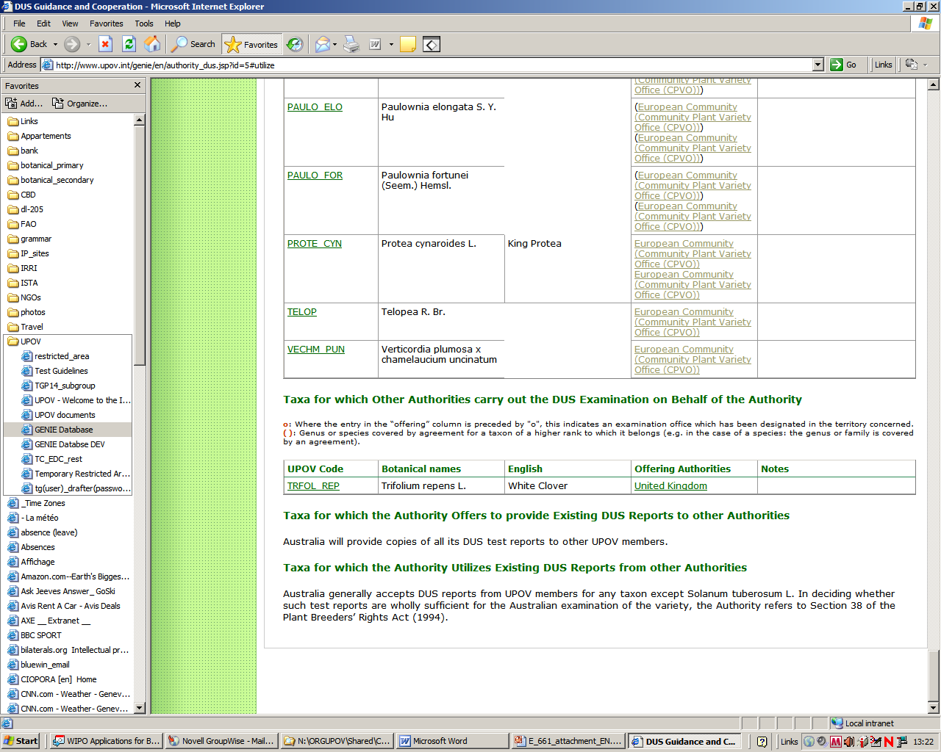
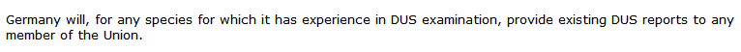
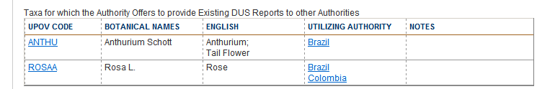
Examples
Australia (AU)
Germany (DE)
Republic of Korea (KR)

Slide 13
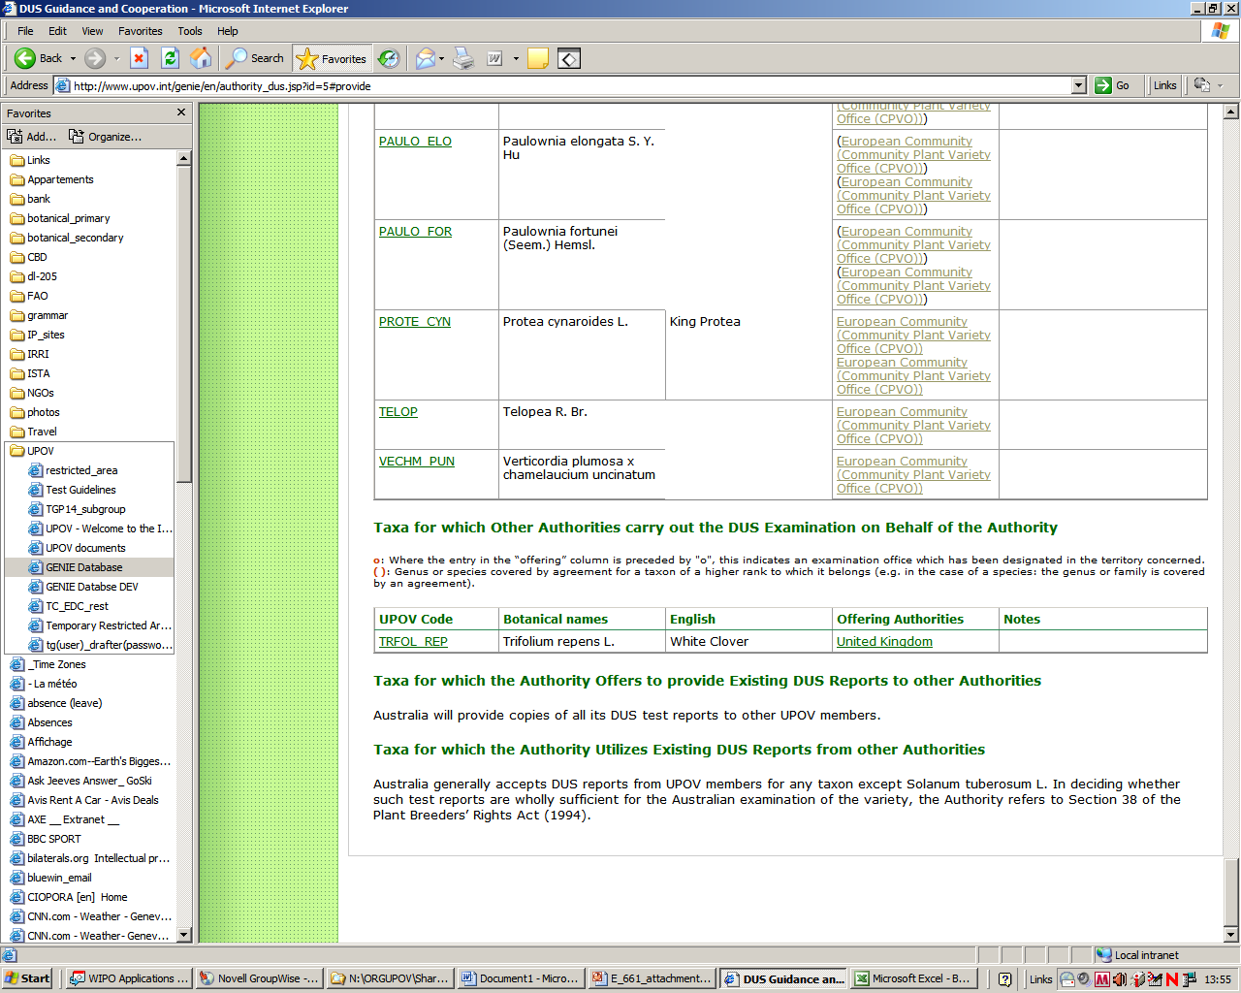
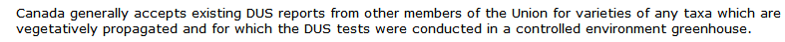
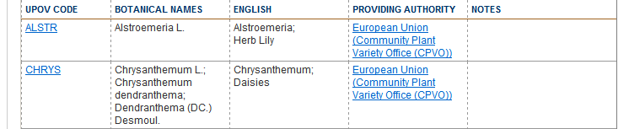
Examples
Australia (AU)
Canada (CA)
Kenya (KE)

Slide 14
If you wish to copy extracts into an Excel worksheet or Word table, please use the procedure explained in
Slides 7 and 8

