Slide 1

Additional Perspectives on Australia’s Implementation of Essentially Derived Varieties
Doug Waterhouse
Chief PBR, IP Australia
UPOV CAJ-AG essentially derived varieties (EDVs), Geneva, 17 October 2014

Slide 2
Outline
What is the EDV problem?
Recall development of Australian PBR law and EDV provisions
  why we did what we did
The 2 essential elaborations needed to establish a “bright line”
Dispute resolution mechanisms – role of national authority
Experience on “predominantly derived”
Conclusion

Slide 3
The problem
How to make EDV work when the text of the Convention is silent on key issues?
Possible Solution: A normative approach using the Vienna Convention on the Law of Treaties 1969.
  Article 31(1) “a treaty should be interpreted in accordance with the ordinary meaning to be given to the terms of the treaty in their context and in light of its object and purpose.”

Slide 4
UPOV’s object and purpose
UPOV Mission Statement
To provide and promote an effective system of plant variety protection, with the aim of encouraging the development of new varieties of plants, for the benefit of society.
Preamble to UPOV 1978 [..] conscious of the special problems arising from the recognition and protection of the rights of breeders and particularly of the limitations that the requirements of the public interest may impose on the free exercise of such a right,
The AU focus is on outcomes and the contribution those outcomes have to society.

Slide 5
Development of Australia’s EDV provisions in conformity with UPOV 91
AU EDV wording follows Convention BUT has 3 important elaborations
  defines what an “essential characteristic” is
  specifies what is not an EDV and how the “EDV chain” is broken
  stipulates that the national authority administers EDV
Purpose of first 2 elaborations are to establish a “bright line” so as to provide clarity and certainty for all stakeholders.
3rd elaboration is to provide low cost dispute resolution

Slide 6
Elaboration 1: Essential characteristics
The PBR Act defines :
“Essential characteristics are heritable traits … that contribute to the principal features, performance or value of the variety”
[emphasis added]

Slide 7
Elaboration 2: PBR Act defines what is NOT an EDV
Requires that important differences (more than cosmetic) in essential characteristics, must be demonstrated if the second variety is not to be declared as an EDV.
  “cosmetic” is interpreted in the context of the second variety and the specific characteristic in question.
    Example: “colour of anthers”

Slide 8
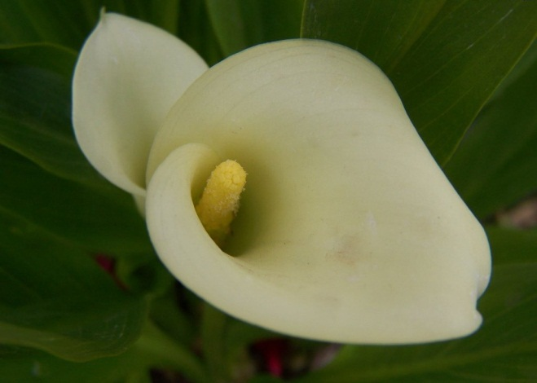
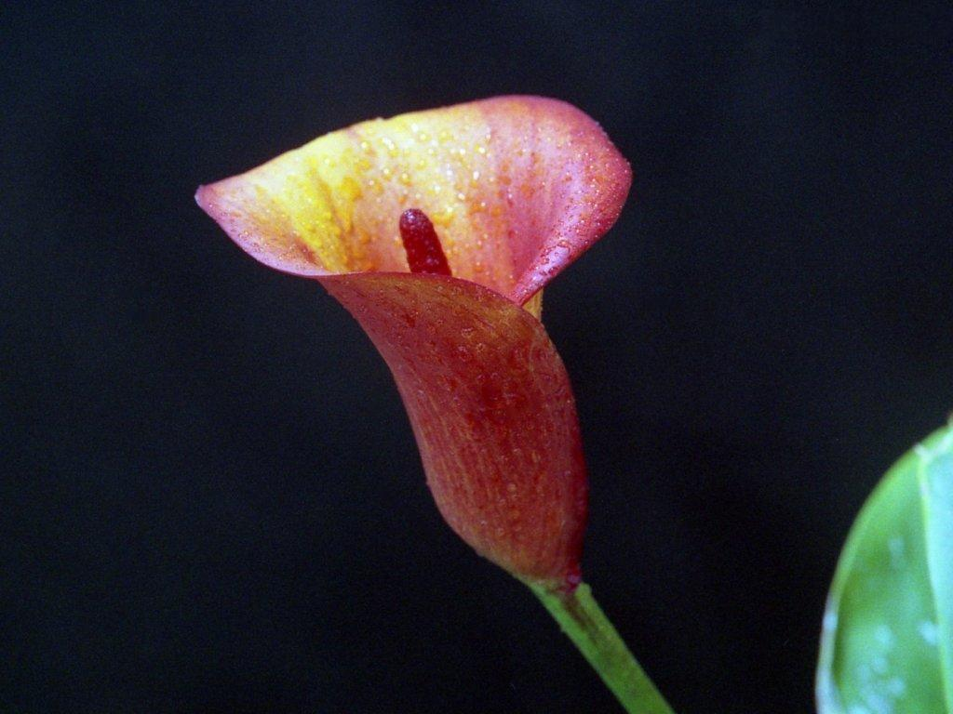
Example: Anther colour
Wheat
Calla Lily
Notes:
Reference: Calla Lily (Zantedeschia) TG/177/3 Char 38. Spandix: main colour just before pollen shed
Top image: Medium yellow (4)
Bottom image: Purple red (9)

Slide 9
A “bright line”
In combination, elaborations 1 and 2 provide objective criteria for assessment of EDV claims
  A “bright line” for decision makers
Stakeholders can predict with some confidence the outcome of EDV disputes.

Slide 10
Elaboration 3: Role of national authority
Is responsible for declarations of EDV (ie court action is not required in the first instance).
3 legislated opportunities for ADR (within binding decisions)
  Assertions of the grantee of the initial variety are assessed “ex parte” by the national authority experienced in PBR matters (AUD$800)
  Any person whose interests are affected by a declaration of EDV may apply to have that declaration revoked (AUD$500)
  Registrar can act on their own initiative to revoke a declaration of EDV eg where facts existed that, had they been known at the time of the declaration, would have resulted in the refusal of the declaration
Appeals to the Administrative Appeals Tribunal and/or the Federal Court are also available.
Industry strongly support role of national authority to administer EDV applications.

Slide 11
Australia’s experiences – “predominantly derived”
2. ‘Sir Walter’ vs ‘Kings Pride’ (2007)
Claim1: Characteristics claimed as distinct (eg longer stolons) are not important but only cosmetic
EDV rejected because Claim 1 failed
Claim 2: ‘Kings Pride’ was predominantly derived from ‘Sir Walter’ because DNA profiling could not distinguish the varieties in any of the primers used
Claim 2 would also have failed because even though both varieties were selected from the same parent material and therefore similar, plants of ‘Sir Walter’ were not used in the breeding of ‘Kings Pride’
  predominantly derived from initial variety was not satisfied.

Slide 12
Conclusions
By defining “essential characteristics” and focussing on the contribution to society made by the second breeder, Australian PBR law provides a workable “bright line” which has been used to:
  clearly identify what is not an EDV
    avoids problems of UPOV Art.14(5)(b)(i) and (iii)
Involving the national authority
  Provides 3 levels of ADR
    avoids expensive courts action
AU uses a literal interpretation of “predominantly derived from the initial variety”

Slide 13
Thank you
Name Doug Waterhouse
Position Chief PBR
Section PBR
Phone +061 2 6283 7981
Email doug.waterhouse@ipaustralia.gov.au

