Slide 1
REPORT BY THE VICE SECRETARY-GENERAL ON DEVELOPMENTS IN UPOV
(document SESSIONS/2024/1)
Ms. Yolanda Huerta, Vice Secretary-General
Geneva, October 21 to 25, 2024

Slide 2
The Framework
UPOV’s Strategic Business Plan (2023-2027) provides the basis for the Program and Budget for the 2026-2027 Biennium

Slide 3
Bring together Stakeholders to help shape the UPOV system

Slide 4
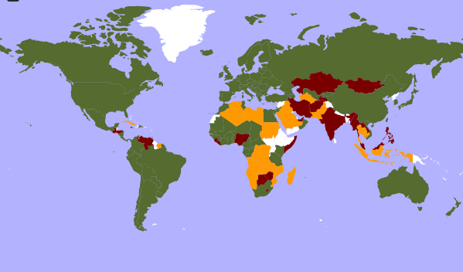
UPOV STATUS – 79th member: Armenia March 2, 2024
States that requested comments on [Draft] Laws (October 2023 to October 2024)
Kazakhstan
Armenia
Saudi Arabia
Pakistan
Bahrain
Thailand
Cambodia
Cabo Verde
Malaysia
The Gambia
Brunei Darussalam
Guatemala
Lao PDR
Ghana
Nigeria
United Arab Emirates
Suriname
Rwanda
Mauritius
Indonesia
Seychelles
Members of UPOV (79) (covering 98 States)
Initiating States (19) and Organization (1)
States (28) and Organization (1) in contact with the UPOV Office

Slide 5
UPOV STATUS
Initiating States (19) and Organization (1)
States (19)
Afghanistan, Brunei Darussalam, Guatemala, Honduras, India, Iran (Islamic Republic of), Jamaica, Kazakhstan, Lao People’s Democratic Republic, Malaysia, Mauritius, Mongolia, Myanmar, Nigeria, Philippines, Tajikistan, United Arab Emirates, Venezuela (Bolivarian Republic of) and Zimbabwe.
Organization (1)
African Regional Intellectual Property Organization (ARIPO)
States (28) and Organization (1) in contact with the UPOV Office
States (28)
Algeria, Antigua and Barbuda, Bahrain, Barbados, Cabo Verde, Cambodia, Cuba, Cyprus, El Salvador, Indonesia, Iraq, Libya, Liechtenstein, Malawi, Mozambique, Namibia, Pakistan, Rwanda, Saudi Arabia, Seychelles, Sudan, Suriname, Thailand, The Gambia, Timor-Leste, Tonga, Turkmenistan and Zambia.
Organizations (1):
Southern African Development Community (SADC)

Slide 6
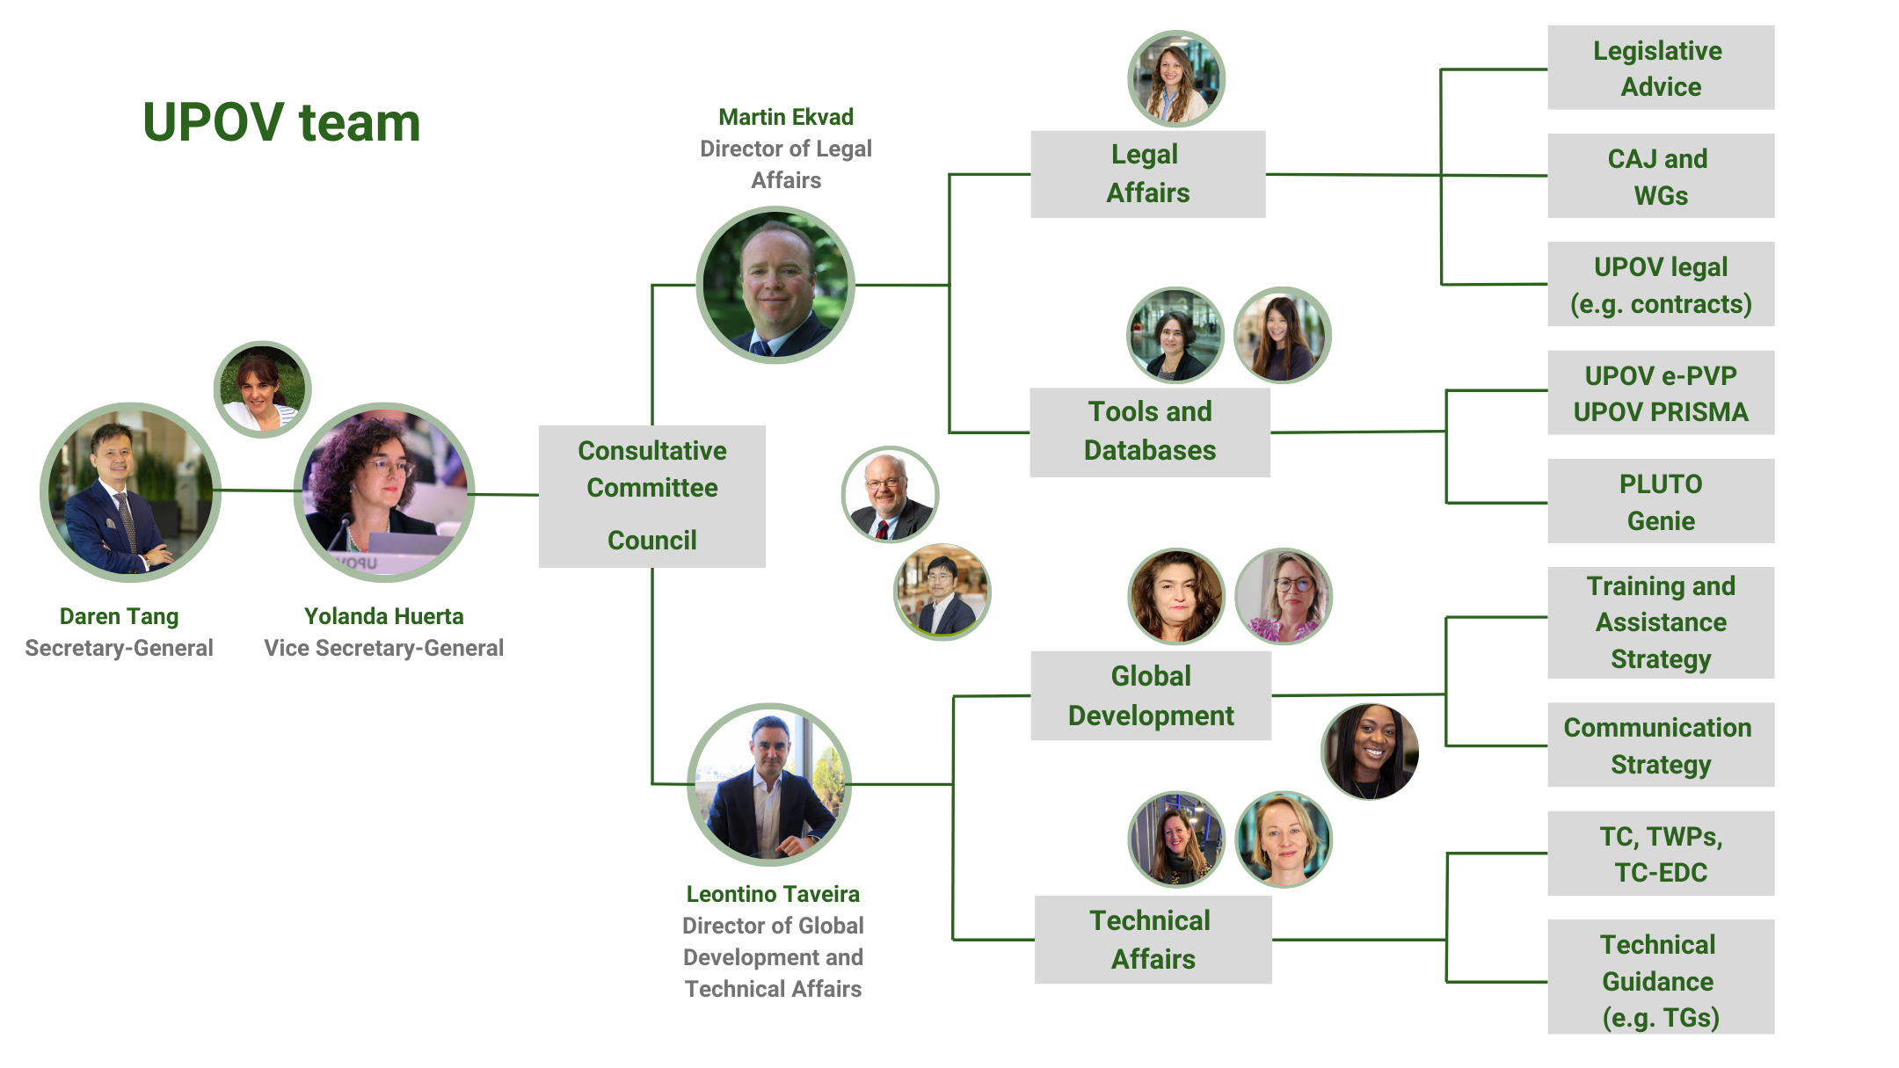
UPOV Team

Slide 7
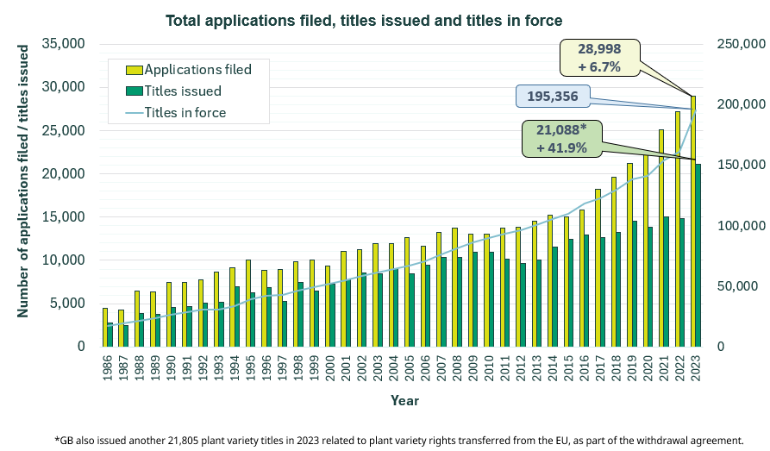
PVP Statistics

Slide 8
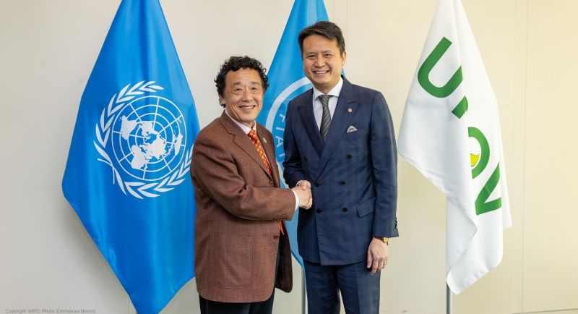
Cooperation with other organizations
Visit to UPOV of FAO DG

Slide 9
Provide information and guidance on the UPOV system

Slide 10
Developments since last UPOV sessions
On 27 October 2023 the UPOV Council adopted new explanatory notes on essentially derived varieties UPOV/EXN/EDV/3 https://www.upov.int/explanatory_notes/en/
UPOV International Certificate on Plant Variety Protection was launched in April 2024 - 42 certificates had been awarded to experts from UPOV members https://www.upov.int/resource/en/pvp_certificate.html

Slide 11
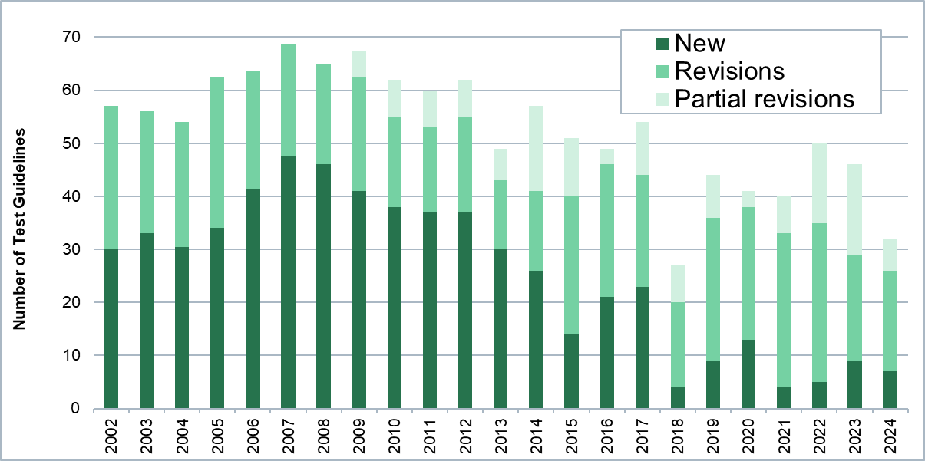
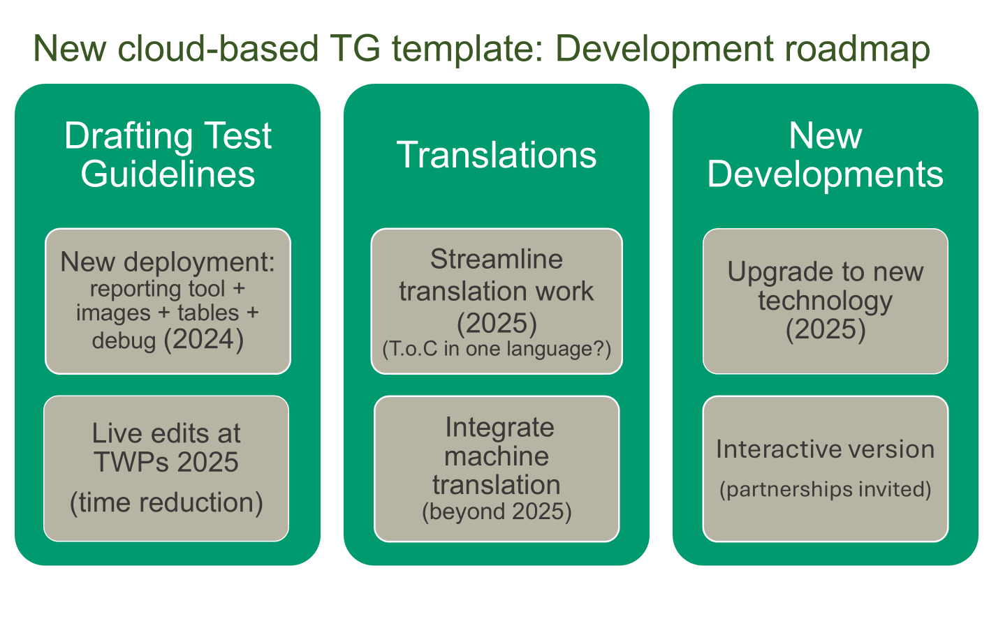
Technical Committee, Sixtieth Session

Slide 12
What’s next? Horizon scanning
How do we increase the understanding of the eco-system that influences plant breeding, protection of new varieties and their commercialization?
Are we moving from selling new varieties to offering a package of integrated services for farmers/growers, including new varieties?
How do the new cutting-edge technologies, such as artificial intelligence (e.g. generative AI, machine learning, deep learning) assist in the development, examination and commercialization of new plant varieties?

Slide 13
What’s next? Horizon scanning – Innovation strategy
How should variety testing evolve to enable continuous progress in plant breeding?
How does the shorter breeding time and commercial life cycle of some new varieties influence the UPOV system?
How to harness cooperation on using DNA-based information to support DUS testing?
How to integrate the perspectives of those UPOV members that provide services and those members that request those services?
How to enhance the role of DNA-based information in the management of variety collections?

Slide 14
What’s next? Horizon scanning – Innovation strategy
How do the new cutting-edge technologies, such as artificial intelligence (e.g. generative AI, machine learning, deep learning) assist in the development, examination and commercialization of new plant varieties?
How could smaller PVP offices enhance cooperation to overcome challenges in variety testing?
To create varieties that are resistant to diseases has become an increasingly important aim that requires substantial investment in breeding.
How can this trend be integrated in UPOV’s technical harmonization work? (e.g. development of Test Guidelines and possible new methods of testing varieties)

Slide 15

Communicating the benefits of the UPOV system

Slide 16
Provide high quality services for UPOV members and users of the UPOV system

Slide 17

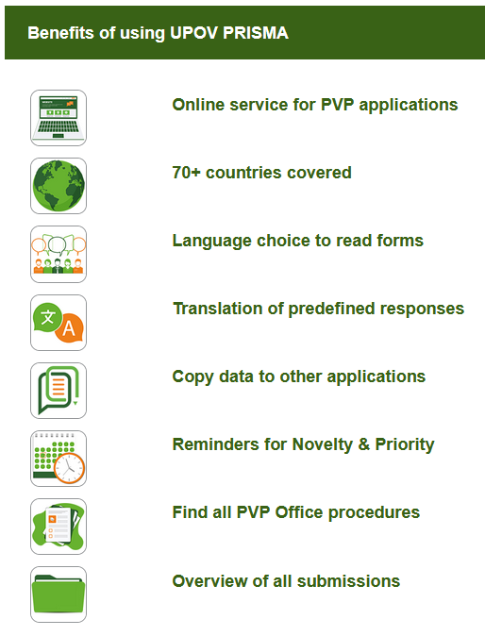
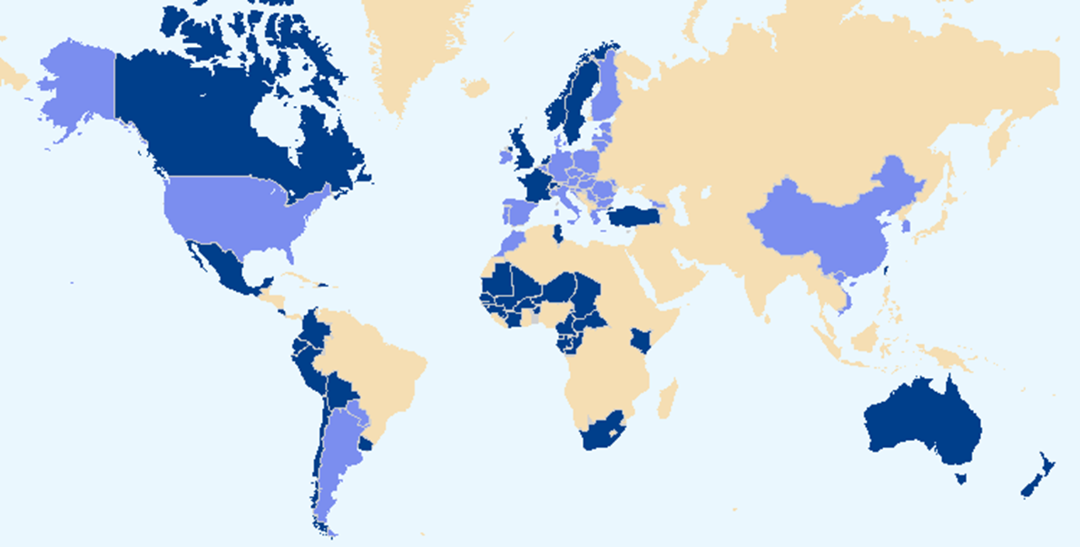

Slide 18




UPOV e-PVP
focus on digitalization services for UPOV members – not leaving anyone behind
APPLICANT
UPOV e-PVP
DUS Report Exchange Module
PVP Office
OTHER PVP OFFICES
PVP Office
PVP OFFICE
PVP Office
UPOV e-PVP Administration Module

Slide 19
Current situation of UPOV e-PVP
UPOV Member | UPOV PRISMA* | UPOV e-PVP Admin Module | UPOV e-PVP DUS Exchange Module
Brazil |  |  | (X)
Canada | X |  | (X)
European Union | X |  | (X)
Georgia | X |  | (X)
Ghana | (X) | (X) | (X)
Japan |  |  | (X)
Morocco | X |  | (X)
Netherlands (Kingdom of) | X |  | X
New Zealand | X |  | (X)
Republic of Tanzania | X
Türkiye | X |  | (X)
United Kingdom | X | (X) | (X)
United States of America | X |  | (X)
Viet Nam | X | X | X
* 28 out of 37 UPOV PRISMA participating authorities have not yet expressed their interest to join UPOV e-PVP admin and/or DUS Exchange module
X: already using
(X): commited to use

Slide 20
What’s next? Horizon scanning – Digital strategy – PVP Office of the future
UPOV e-PVP is the key service and enabler of this strategy for UPOV members and stakeholders. UPOV e PVP serves as:
catalyst for effective digital PVP operations for new members
bridge for digitally mature PVP offices
innovative hub for addressing global challenges (i.e. data ownership and access)
connector of digital systems - those from users and PVP offices

Slide 21
What’s next? Horizon scanning – Digital strategy
How can UPOV invest in cost-effective and scalable digital tools to streamline operations, achieve efficiency, and enhance harmonization?
What global challenges, such as data ownership and access, need to be addressed to offer a reliable hub for UPOV members and stakeholders?
How can we effectively connect UPOV members and stakeholders regardless of their digital capabilities?

Slide 22


